Slide 1
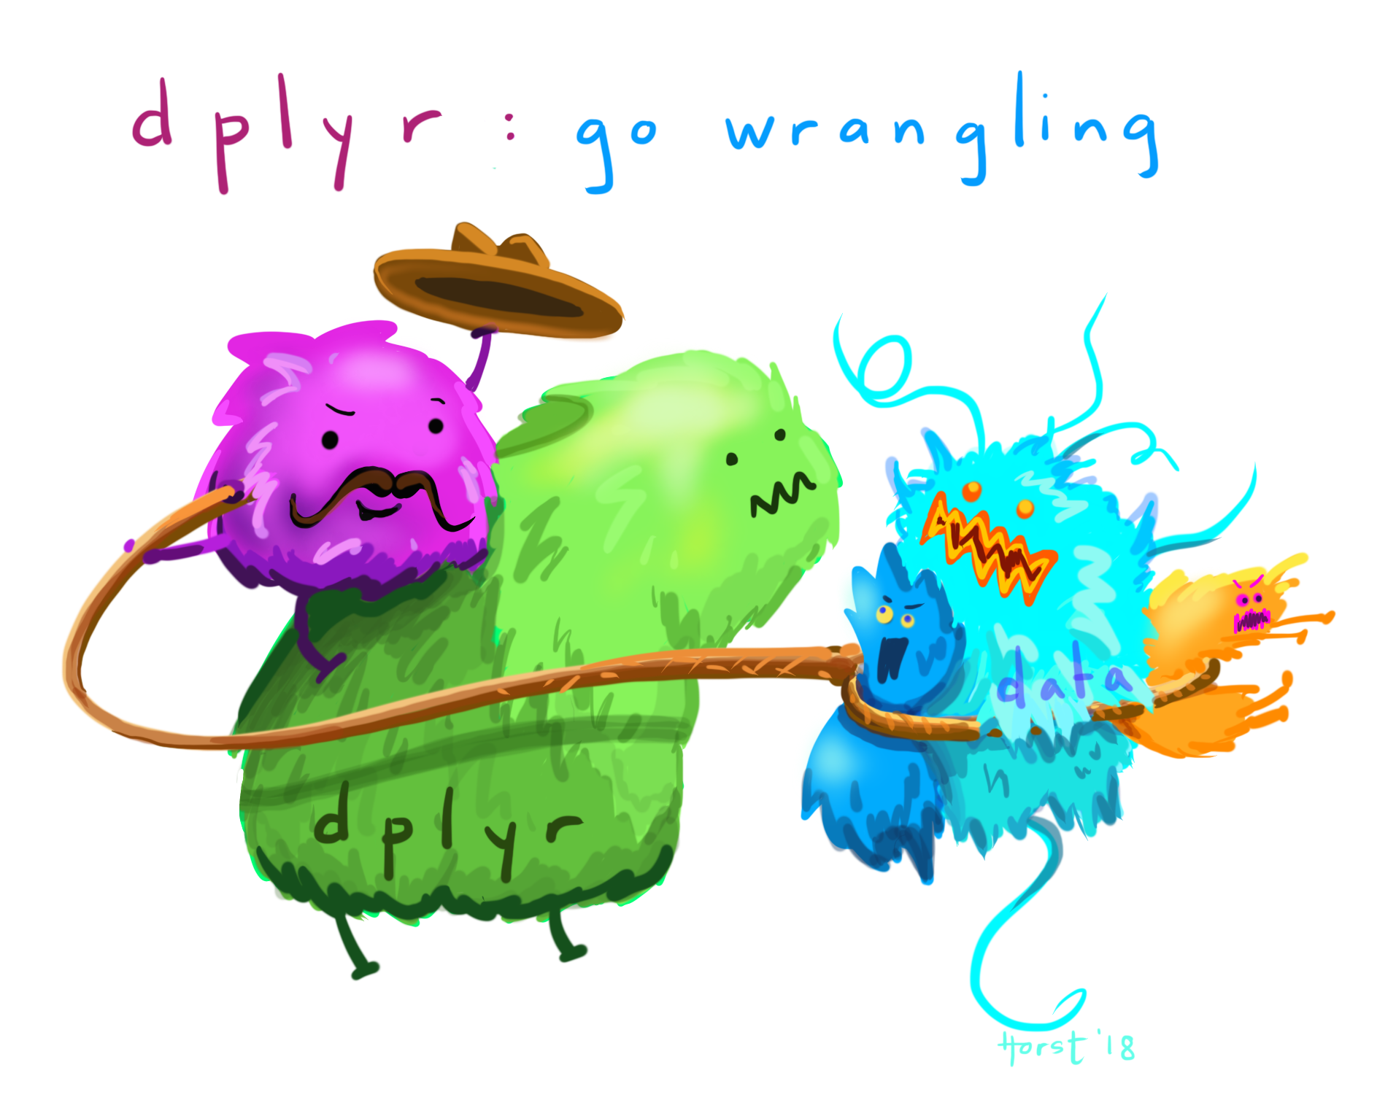
Stat 20: Introduction to Probability and Statistics
Artwork by @allison_horst
Module 2, Part 2, Lecture 2 (part 2: dplyr)
Introducing the tidyverse package dplyr

Slide 2
Subsetting with dplyr
Install the package dplyr (you need to do this once)
Load dplyr using library() (you need to do this for each new session of Rstudio)
Basic functions for subsetting:
filter()
arrange()
select()
mutate()
summarise()
and we will use group_by()
Notes:
filter subsets of observations

Slide 3
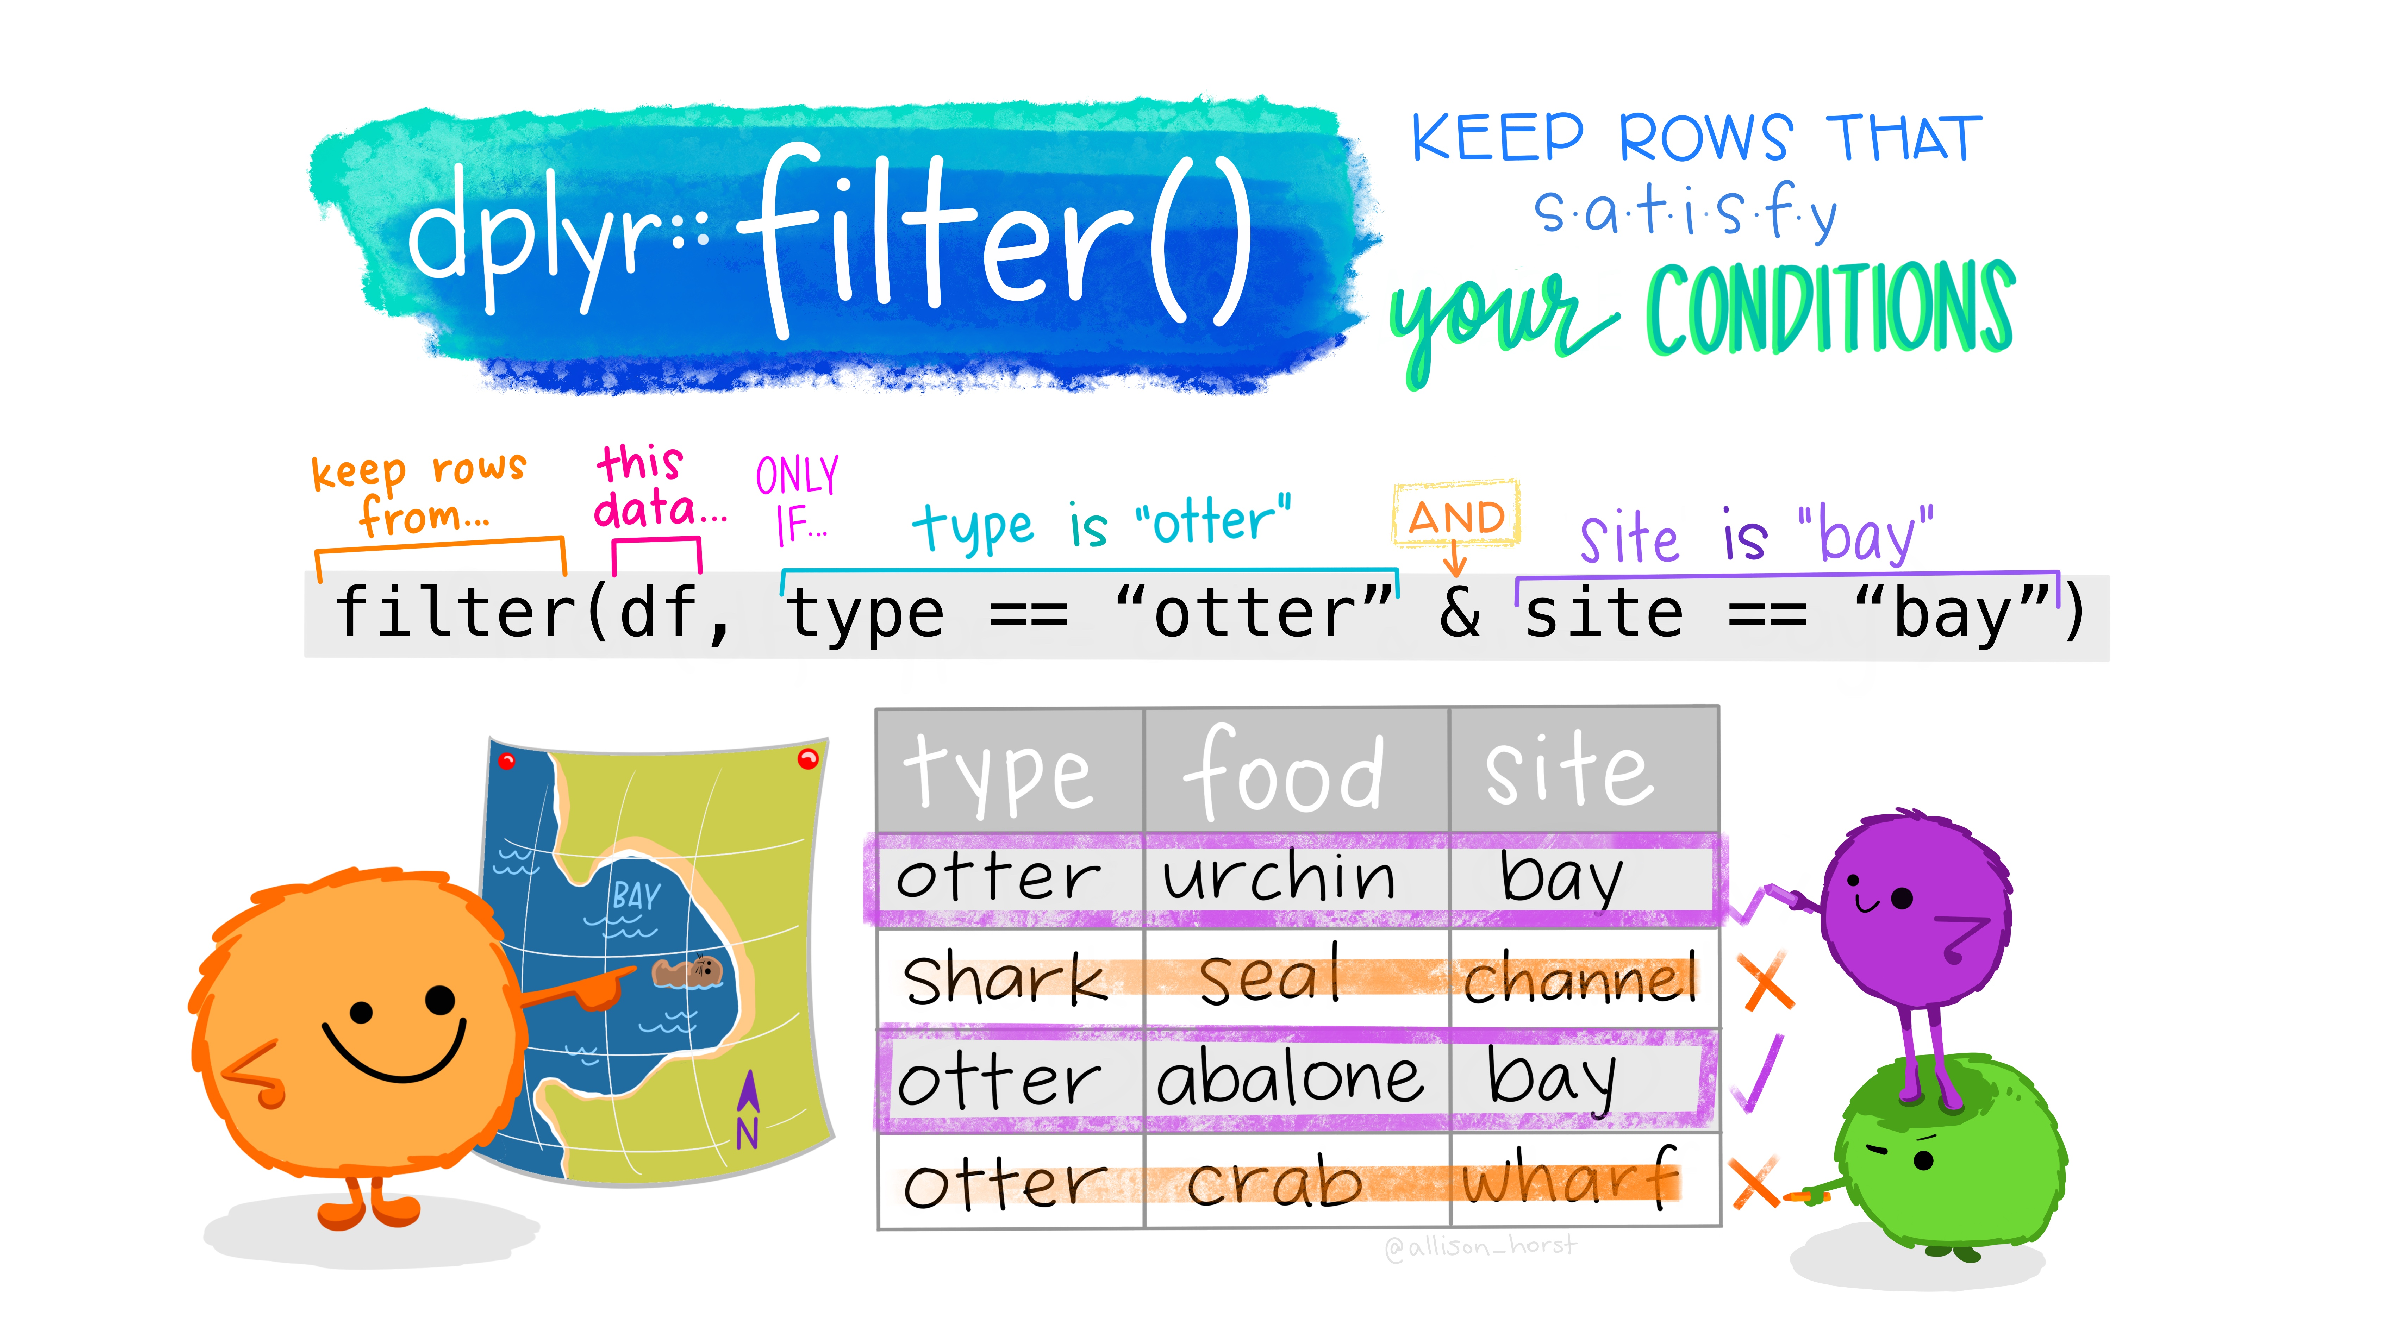
filter( )
Artwork by @allison_horst

Slide 4
> family
firstName gender age height weight bmi overWt
1 Tom m 77 70 175 25.16239 TRUE
2 May f 33 64 125 21.50106 FALSE
3 Joe m 79 73 185 24.45884 FALSE
4 Bob m 47 67 156 24.48414 FALSE
5 Sue f 27 64 105 18.06089 FALSE
6 Liz f 33 68 190 28.94981 TRUE
7 Jon m 67 68 185 28.18797 TRUE
8 Sal f 52 65 124 20.67783 FALSE
9 Tim m 59 68 175 26.66430 TRUE
10 Tom m 27 71 215 30.04911 TRUE
11 Ann f 55 67 166 26.05364 TRUE
12 Dan m 24 66 140 22.64384 FALSE
13 Art m 46 66 150 24.26126 FALSE
14 Zoe f 48 62 125 22.91060 FALSE

Slide 5
filter()
First entry is the dataframe, and then we tell R how to select rows according to some logical or comparison condition.
There are the usual comparison operators:
<, <=, >, >=, !=, ==
The logical operators are &(and), | (or), !(not)
filter(data, condition) returns all rows for which the condition is TRUE.
To try later:
> filter(family, bmi>=28)

Slide 6
arrange()
arrange() works similarly to filter()
Instead of selecting rows, it changes their order.
Inputs: a data frame and a set of column names (or more complicated expressions) to order by.
If you provide more than one column name, each additional column will be used to break ties in the values of preceding columns
To try later:
> arrange(family, bmi)
> arrange(family, desc(bmi))
What is the difference?

Slide 7
select()
select()works similarly to filter()
Both are basic functions. filter() selects rows according to specified conditions, while select() selects variables (columns)
> select(family, weight)
> select(family, -height)
> select(family, ends_with("eight"))
> select(filter(family,age>50 & height<70), gender)
> select(filter(family,age > 50 & height < 70),name, gender)

Slide 8
slice()
slice()selects the rows by indicating position
slice(data, rows to keep or drop)
> slice(family, 1)
> slice(family, -3:-14)
> slice(family, 5:n())

Slide 9
Other functions: mutate and rename
mutate() adds columns that might be functions of other columns or just new columns
mutate(data, new column name = definition of new col)
rename just renames a column
rename(data, new column name = old name)

Slide 10
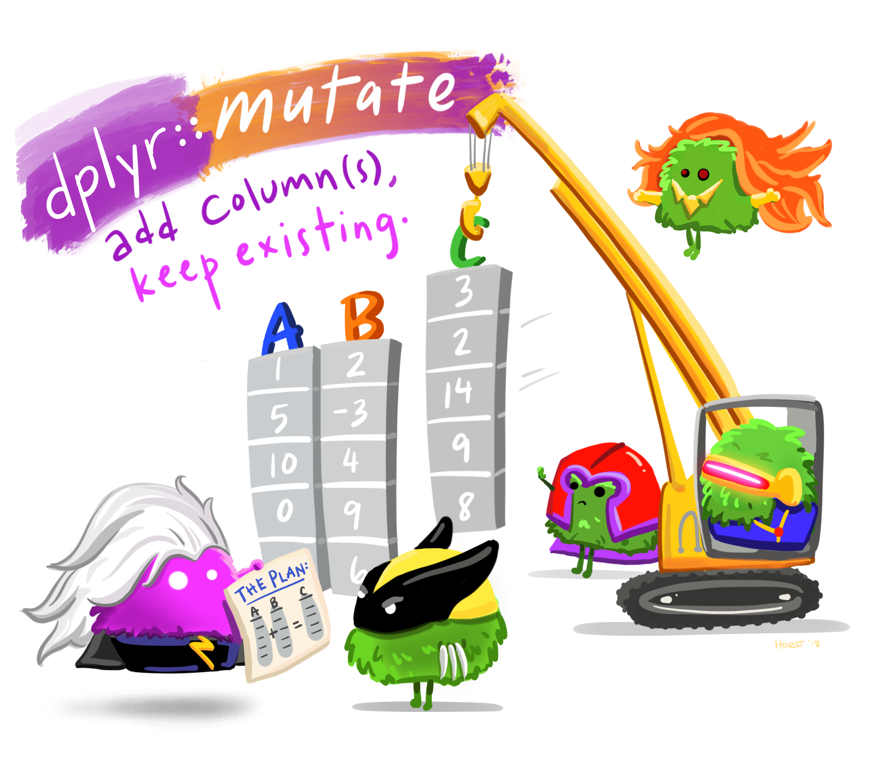
Mutate()
Artwork by @allison_horst

Slide 11
Examples of subsets
Ages of those who are not overweight
select(filter(family, !overWt), age)
Weights of women in the family
select(filter(family, gender ="f"), weight)
Genders of those over 50 years old and under 70 inches tall
select(filter(family, age > 50 & height < 70), gender)

Slide 12
Examples of subsets
Tallest member of the family
> slice(family, which.max(height))
Every other person in the family
> slice(family, seq(1,nrow(family), by = 2))
New vector of last names all “Smith”
> family = mutate(family,lastName = "Smith")

Slide 13
More complicated: subgroups, use summarise()
Suppose we want to look at the average weight, and the height of the tallest men and women in our family
> mf_group = group_by(family, gender)
> summarise(mf_group, avg_wt = mean(weight),
tallest = max(height))
sex avg_wt tallest
<fctr> <dbl> <int>
f 137.8333 68
2 m 172.6250 73
Notes:
created the group, we don’t see a difference, but R has added the attribute.

Slide 14
Exercise
Exercise: Randomly select 3 rows from the family dataframe.
Hint: Use one of the dplyr functions discussed earlier, and another function that has been discussed in previous lectures.
Notes:
slice(family,sample(nrow(family),3))

